Slide 1
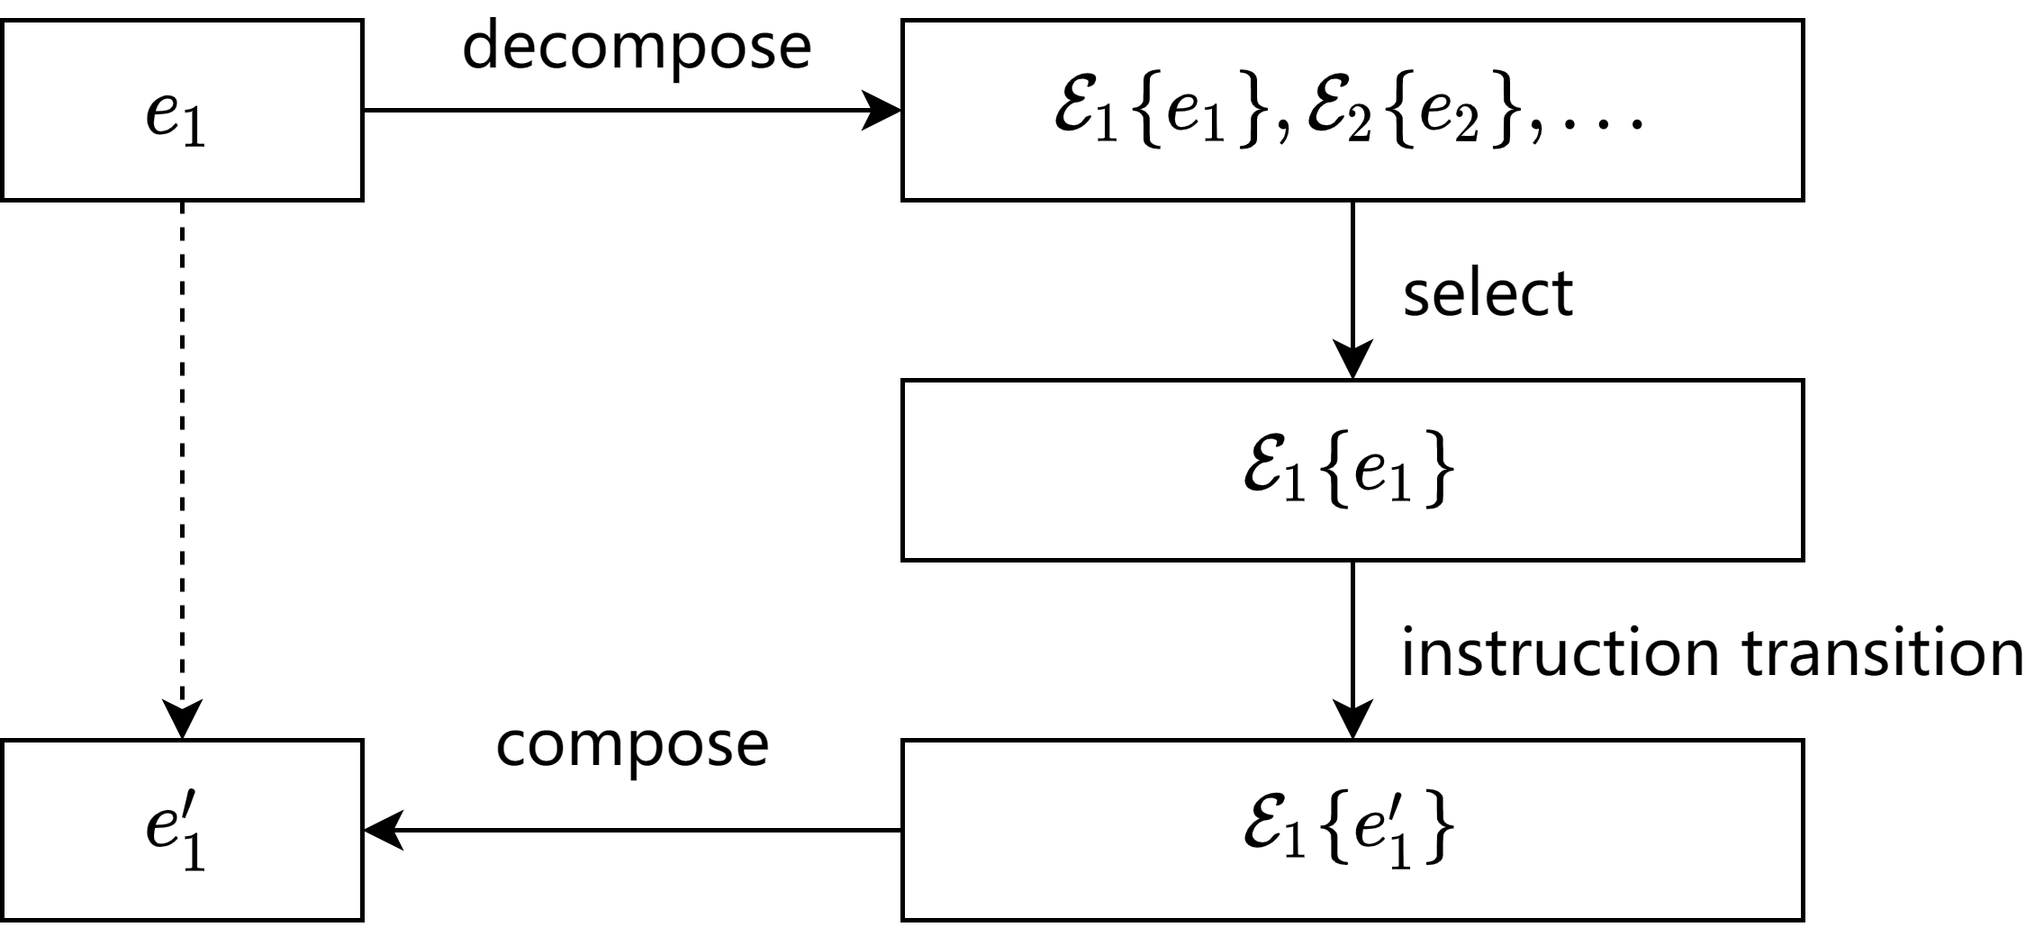
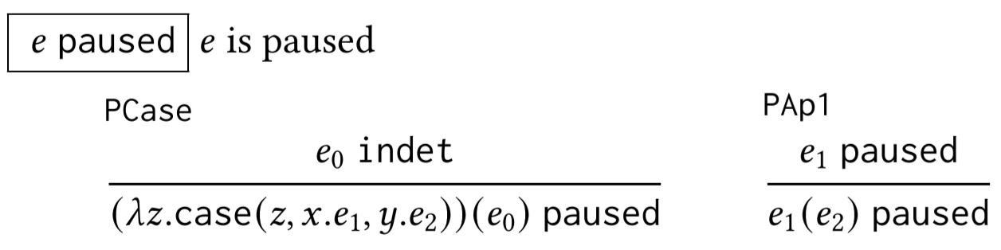

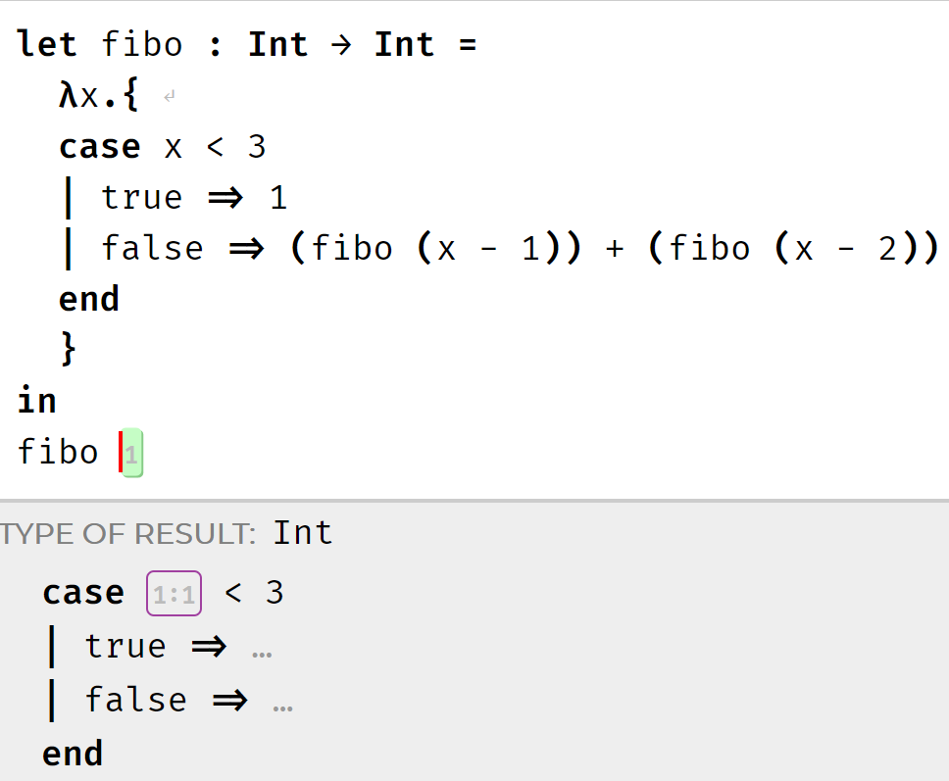
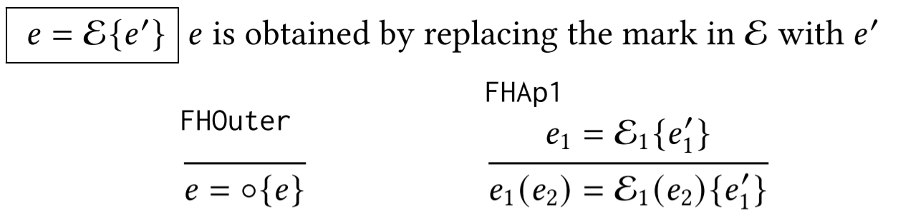
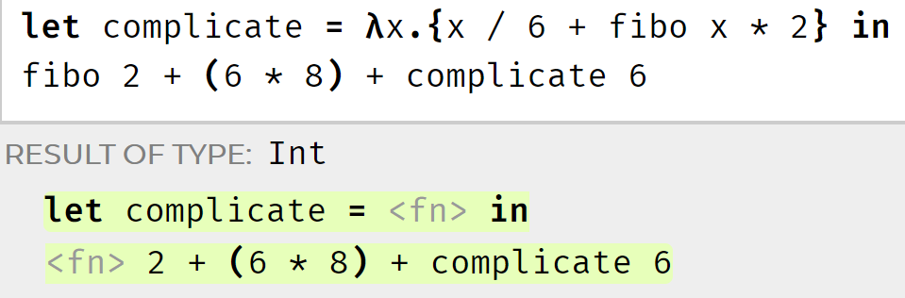

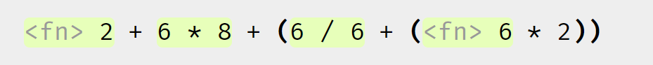
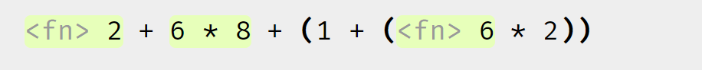
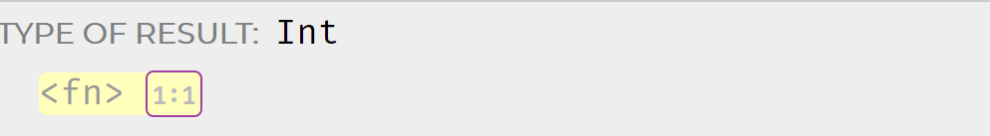
An Interactive Stepper for Expression with Holes
Student Research Competition
Category: undergraduate
ICFP 2021
Yanjun Chen
University of Michigan, Ann Arbor, MI
Advisor: Cyrus Omar
Introduction
We implement the feature by introducing paused judgement, denoted as e paused. This paused judgement is designed to simplify the output of the program. Therefore, the paused expression is steppable but this needs user’s confirmation. The judgement is shown in Figure 2.
We develop an interactive stepper that can pause to avoid showing unnecessary details and provide options for the user to choose where to step. We implement this stepper for Hazel (hazel.org), a pure functional programming environment assigning semantic meaning to incomplete programs. It contains a special form called a hole indicating missing expressions.
Paused Function Application
Figure 4: Structure of stepper.
Figure 2: Paused forms. PCase is the case that function application with an indeterminate argument. Other rules make paused judgement propagate up.
The structure of our stepper is shown in Figure 4. The expression is first decomposed into many independent evaluation contexts by a function called decompose shown in Figure 5. Then, user may choose one of them to step. And the stepper will compose them into final result.
Figure 1 is an example of calculating fibonacci number. The function definition is complete while the function call contains a hole. The full evaluation result is a case expression with a hole as parameter. However, Hazel will show all details which take a lot of space and may not be relevant to the user. Therefore, our stepper will pause evaluation until user requires it to step further.
Stepping with Multiple Choices
Figure 3 is an example of an expression with many parts. If user wants to debug the right part, user has to click many times to reduce the left one first since there exists only one way to step for any non-final programs according to the regular evaluation order for Hazel. Our stepper can provide options for user to choose where to step as shown in Figure 3.
Figure 5: Decomposition function.
Conclusion
Full evaluation:
We develop an interactive stepper for Hazel, a programming environment with holes. It uses the paused judgement to provant evaluating function application when argument is indeterminate. Also, we develop a simple algorithm for decomposition that can find all subexpressions which need to evaluate. We use the contextual dynamics to progress the expression for stepper. This result may be useful for debugging or educational purpose. We plan to evaluate these tools in an educational setting in the future.
Paused evaluation:
Figure 3: Example of choosing which active expression to evaluate. Evaluation contexts highlighted as green boxes. User can click the green boxes to perform the reduction.
Figure 1: Example of paused evaluations. Yellow box indicates the paused expression. User can click on it to continue the evaluation.
The structure of our stepper is shown in Figure 4. The expression is first decomposed into many independent evaluation contexts. Then, user may choose one of them to step. And the stepper will compose them into final result. This structure is similar with the stepper developed by Cong and Asai [2016]. The main difference is they decompose the expression into only one evaluation context while our stepper provides many contexts.
We have judgement like e final, e boxedval for expression e [Omar et al. 2019]. Furthermore, since Hazel contains incomplete programs, there exists some programs that cannot be stepped further but not a boxed value, which induces a judgement denoted as e indet.
Reference
Cyrus Omar, Ian Voysey, Ravi Chugh, and Matthew A. Hammer. 2019. Live Functional Programming with Typed Holes. Proc. ACMProgram. Lang. 3, POPL, Article 14 (Jan. 2019), 32 pages. https://doi.org/10.1145/3290327.
Youyou Cong and Kenichi Asai. 2016. Implementing a stepper using delimited continuations. In 7th International Symposium on Symbolic Computation in Software Science, SCSS 2016, Tokyo, Japan, March 28-31, 2016 (EPiC Series in Computing, Vol. 39), James H. Davenport and Fadoua Ghourabi (Eds.). EasyChair, 42–54. https://easychair.org/publications/paper/7qlb.

